Slide 1

Working With Data DATA9910
Week 12
Lucas Rizzo
email: lucas.rizzo@tudublin.ie
Notes:
Entered text
Slide 1: Introduction
Start with a brief introduction to the topic of image processing.
Mention that it's a crucial field in today's digital age.
Explain that you'll be covering the basics, real-world applications, and key terminology.
Slide 2: What is Image Processing?
Define image processing as the manipulation of an image to extract information or enhance its features.
Mention its wide range of applications, from photography to medical imaging.
Slide 3: Importance of Image Processing
Discuss the importance of image processing in various fields:
Medical: Diagnosis and treatment planning.
Entertainment: Special effects in movies and video games.
Security: Face recognition and surveillance.
Agriculture: Crop analysis and yield prediction.
Manufacturing: Quality control and defect detection.
Emphasize how it improves decision-making, saves time, and reduces errors.
Slide 4: Real-world Applications
4.1: Medical Imaging
Explain how image processing is used in medical imaging.
Mention applications like MRI, CT scans, and X-rays.
Highlight its role in disease detection and treatment planning.
4.2: Entertainment
Discuss how image processing enhances visual effects in movies and video games.
Mention CGI (Computer-Generated Imagery) and motion capture technology.
4.3: Security
Explain image processing's role in security through face recognition and surveillance systems.
Emphasize its significance in crime prevention and national security.
4.4: Agriculture
Discuss its applications in agriculture, such as crop analysis and yield prediction.
Explain how it helps farmers make informed decisions.
4.5: Manufacturing
Describe how image processing is used in manufacturing for quality control and defect detection.
Mention its role in ensuring product consistency.

Slide 2
Indicative schedule
Week 1 | Set up environment and R notebook
Week 2 | Review Python and practice
Week 3 | Review R Importing data with R
Week 4 | Intro SQL and aggregate queries
Week 5 | Databases and scripting languages (To be submitted)
Week 6 | Interpreting Data (summary statistics, data visualisation)
Week 7 | Review week
Week 8 | Data manipulation in R Pandas and Numpy
Week 9 | Data visualisation in Python Data processing (regular expressions)
Week 10 | Audio data (R and tuneR) (To be submitted)
Week 11 | Image data (Python and skimage) (To be submitted)
Week 12 | Time series (Python and Pandas)
Week 13 | Working on Assignment Assignment deadline

Slide 3
Overview
Time series data definition
Loading and converting time series data
Manipulating time series
Example visualisations for time series

Slide 4
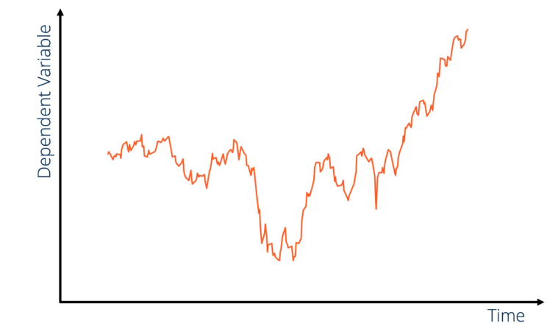
Time series data
Time series data is an important form of data in many different fields, such as finance, economics, ecology, neuroscience, and physics.
Anything that is recorded repeatedly at many points in time forms a time series.
Time series can have a fixed frequency or be irregular without a fixed unit of time or offset between units.

Slide 5
Time series data
value component (quantitative or categorical data)
Time series data is an important form of data in many different fields, such as finance, economics, ecology, neuroscience, and physics.
Anything that is recorded repeatedly at many points in time forms a time series.
temporal dimension
Time series can have a fixed frequency or be irregular without a fixed unit of time or offset between units.

Slide 6
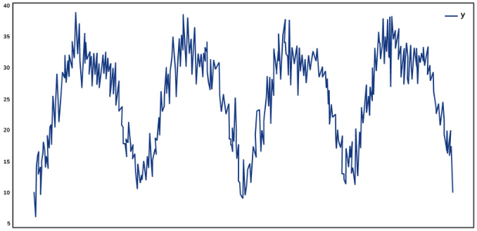
Time series data
Temporal insights: It allows us to uncover trends, patterns, and dependencies that may not be apparent in a single point or period of time.
Data can reflect real-world phenomena such as stock prices, weather, user activity, and more.
Climate Time Series
Temperature
2013-01-01
2013-07-20
2014-02-05
2014-08-24
2015-03-12
2015-09-28
2016-04-15
2016-11-11

Slide 7
Applications
Time series data can be used for:
Forecasting: modeling and forecasting, like predicting stock prices, sales, and demand.
Anomaly Detection: identifying unusual patterns or anomalies in data, crucial for fraud detection and cybersecurity.
Monitoring and Control: helping monitor system performance and make real-time adjustments.
Sensor Data: IoT applications, where sensors generate time-stamped data for various measurements.

Slide 8
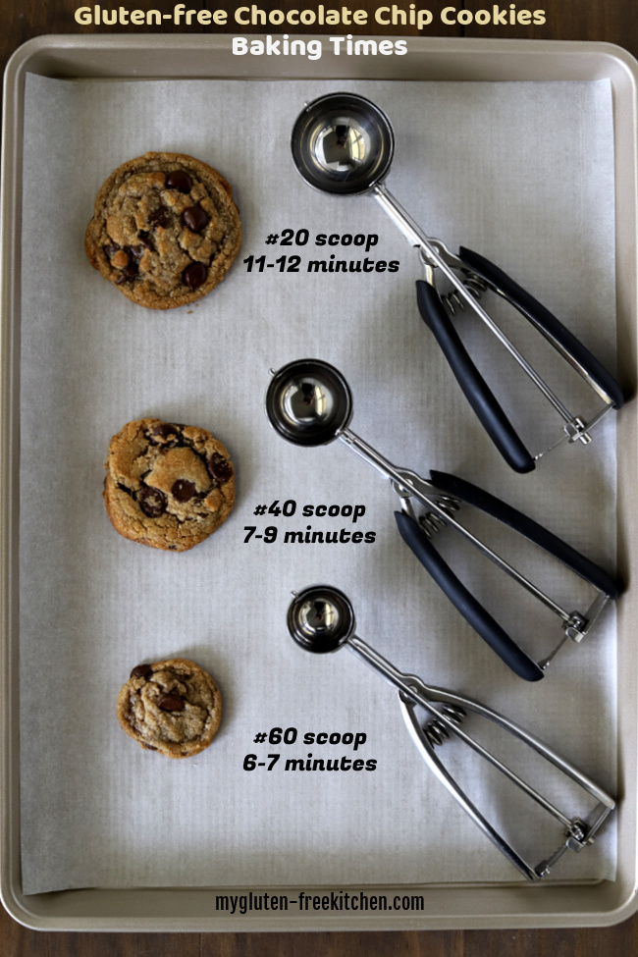
Types of time series data
Diameter of a cookie baking each minute since being placed in the oven
Type depends on the application
Timestamps: specific instants in time.
Fixed periods: such as the whole month of January 2017, or the whole year 2020.
Intervals of time: indicated by a start and end timestamp. Periods can be thought of as special cases of intervals.
Experiment or elapsed time: each timestamp is a measure of time relative to a particular start time starting from 0.

Slide 9
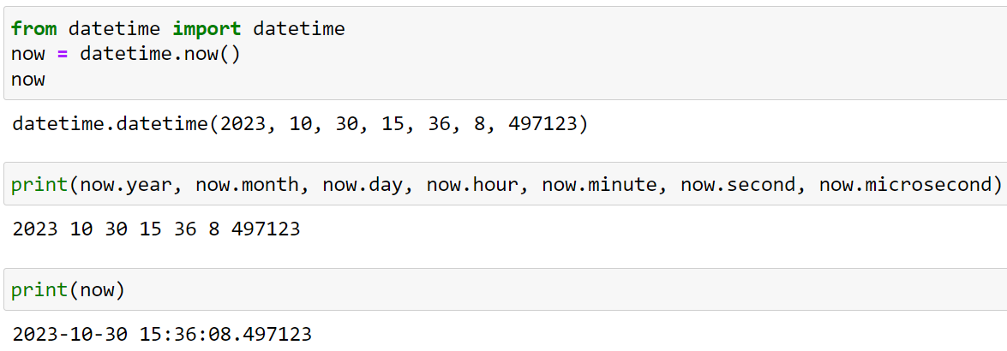
Time Series Basics
Python standard datetime library includes data types for date and time data

Slide 10
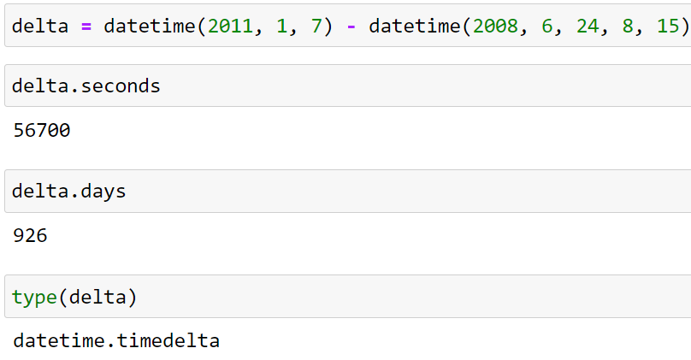
Time Series Basics
timedelta is used to represent the temporal difference between two datetime objects

Slide 11
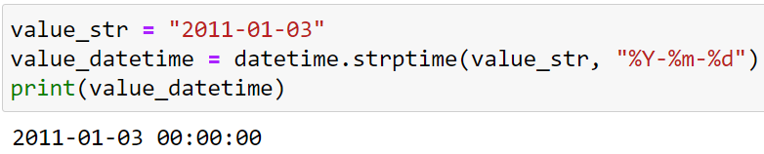
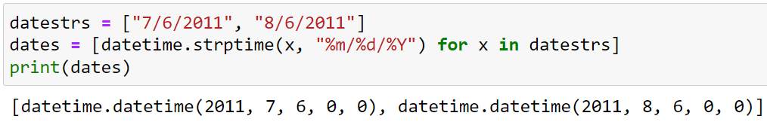
Time Series Basics
The strptime method can convert str objects to date time objects passing a format specification:

Slide 12
Task 1
Check the documentation for the strftime and strptime method here.
Given the following time string '2023-10-26 14:45:00' create a datetime object with strptime .
Use the datetime object and create two strings with strftime. The strings should have the following format:
Month DD, YYYY - HH:MM AM/PM
HH:MM AM/PM
Answer in the next slide...

Slide 13
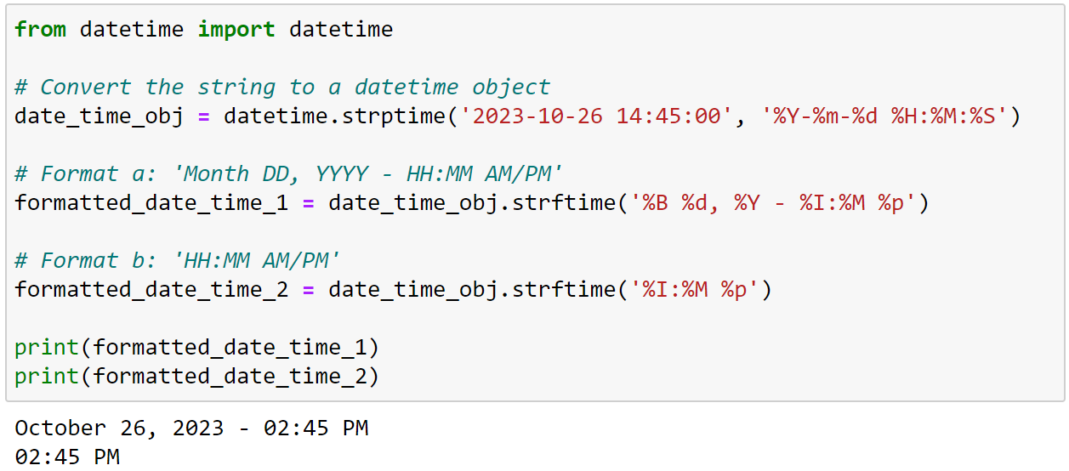
Task 1

Slide 14
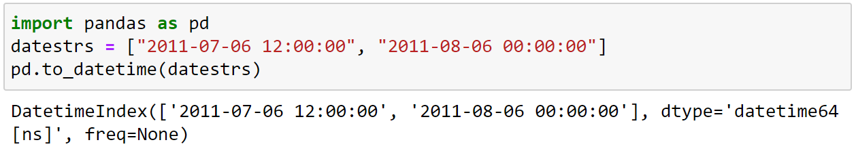
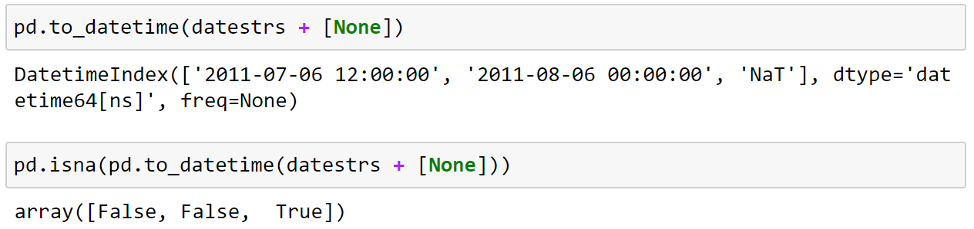
Time Series Basics
Pandas is also able to work with dates. The pandas.to_datetime method parses many different kinds of date representations.

Slide 15
Time Series Basics
Pandas is also able to work with dates. The pandas.to_datetime method parses many different kinds of date representations.
It can handle missing values as ‘NaT’ (not a time)

Slide 16
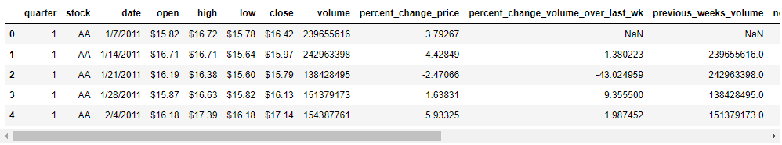
Loading and handling time series data
To load time series data we can use the read_csv method from pandas. For example:
data = pd.read_csv('dow_jones_index.csv') data.head()

Slide 17
Task 2
Download the dow_jones_index.csv file from brightspace and load it using read_csv
Create a copy of the dataframe containing only IBM stock information.
Use pd.to_datetime to convert the date column to the correct type.
Set the date column as the index using set_index
Get the first and last date in the series
Answer in the next slide...

Slide 18
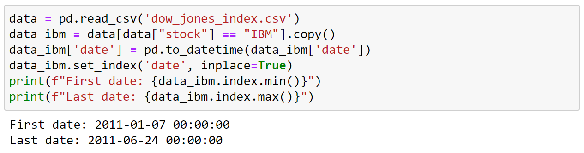
Task 2

Slide 19
Task 3
Change the open column to float. Hint: you will need to format it to remove the $
Using the plot function plot the open price for IBM stocks from January 2011 till February 2011. Hint: you can use slice to get a subset of the dataframe.
Answer in the next slide...

Slide 20
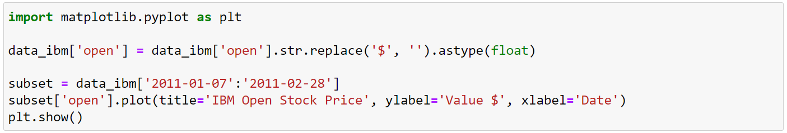
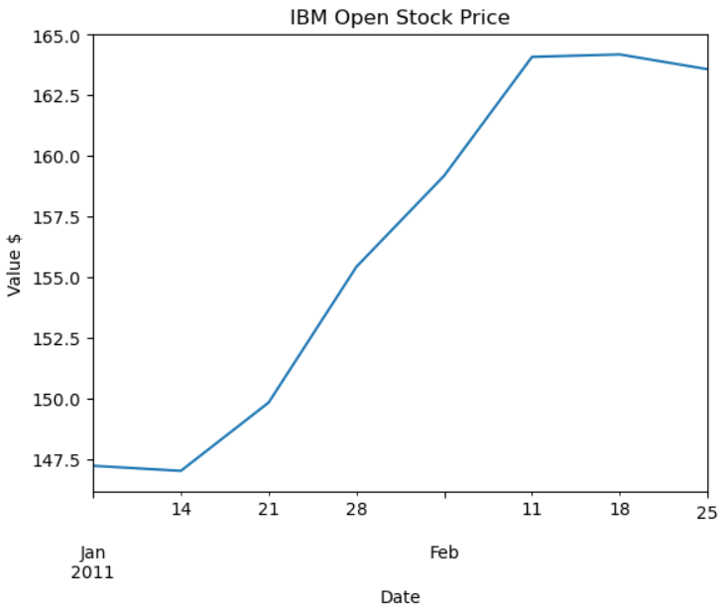
Task 3

Slide 21
Resampling and Frequency Conversion
Resampling: the process of converting a time series from one frequency to another. Possible types (but not all) include:
Downsampling: higher frequency data to lower frequency data. Usually though data aggregation.
Upsampling: lower frequency data to higher frequency data. Usually through interpolation.

Slide 22
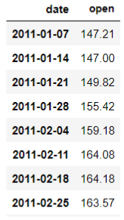
Resampling and Frequency Conversion
IBM Open Weekly Stock Prices

Slide 23

Resampling and Frequency Conversion
data_ibm.resample("ME").mean()
Open Monthly Stock Prices. Aggregation through the mean.
Downsampling
IBM Open Weekly Stock Prices

Slide 24
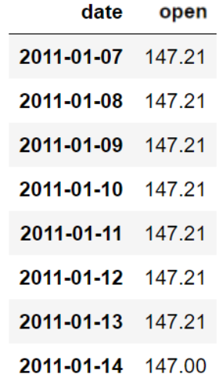
Resampling and Frequency Conversion
data_ibm.resample("ME").mean()
Open Monthly Stock Prices. Aggregation through the mean.
Downsampling
Propagated till next occurrence
Upsampling
IBM Open Weekly Stock Prices
data_ibm.resample('D').ffill()

Slide 25
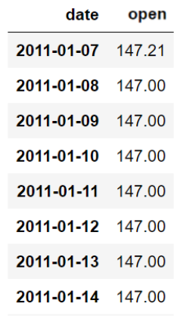
Resampling and Frequency Conversion
data_ibm.resample("ME").mean()
Open Monthly Stock Prices. Aggregation through the mean.
Downsampling
Propagated till next occurrence
Upsampling
IBM Open Weekly Stock Prices
Propagated till next occurrence
data_ibm.resample('D').ffill()
data_ibm.resample('D').bfill()

Slide 26
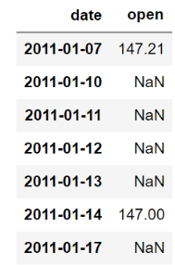
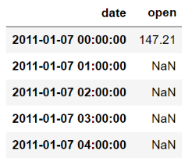
Resampling and Frequency Conversion
The asfreq method can be used to convert time series data to a different frequency.
It does not aggregate data; instead, it changes the frequency of the data while maintaining the existing values.
data_ibm.asfreq("B")
Business day frequency.
data_ibm.asfreq("H")
Hourly frequency.

Slide 27
Task 4
Still using the IBM stock values, resample the high feature to monthly intervals, keeping the maximum value of each month (you will also need to convert high to float).
Resample the monthly values to quarterly, keeping the mean of each month.
Hint: check the possible aggregation functions for resample here
Answer in the next slide...

Slide 28
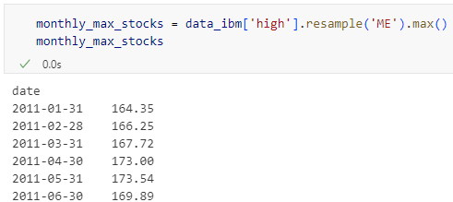
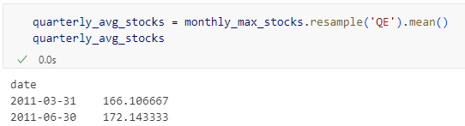
Task 4

Slide 29
Moving Window Functions
Commonly, statistics and other functions for time series data are evaluated over a sliding window.
Window functions calculate metrics for the data inside the window

Slide 30
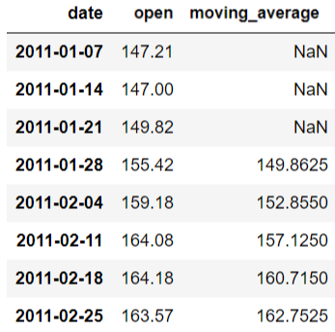
Moving Window Functions
Commonly, statistics and other functions for time series data are evaluated over a sliding window.
Window functions calculate metrics for the data inside the window
4-week moving average window, to calculate mean open stock price from the previous 4 weeks.

Slide 31
Moving Window Functions
Commonly, statistics and other functions for time series data are evaluated over a sliding window.
Window functions calculate metrics for the data inside the window
4-week moving average window, to calculate mean open stock price from the previous 4 weeks.

Slide 32
Moving Window Functions
Commonly, statistics and other functions for time series data are evaluated over a sliding window.
Window functions calculate metrics for the data inside the window
4-week moving average window, to calculate mean open stock price from the previous 4 weeks.

Slide 33
Moving Window Functions
Commonly, statistics and other functions for time series data are evaluated over a sliding window.
Window functions calculate metrics for the data inside the window
4-week moving average window, to calculate mean open stock price from the previous 4 weeks.

Slide 34
Moving Window Functions
Commonly, statistics and other functions for time series data are evaluated over a sliding window.
Window functions calculate metrics for the data inside the window
4-week moving average window, to calculate mean open stock price from the previous 4 weeks.

Slide 35
Moving Window Functions
Commonly, statistics and other functions for time series data are evaluated over a sliding window.
Window functions calculate metrics for the data inside the window
4-week moving average window, to calculate mean open stock price from the previous 4 weeks.

Slide 36
Moving Window Functions
Commonly, statistics and other functions for time series data are evaluated over a sliding window.
Window functions calculate metrics for the data inside the window
4-week moving average window, to calculate mean open stock price from the previous 4 weeks.

Slide 37
Moving Window Functions
Commonly, statistics and other functions for time series data are evaluated over a sliding window.
Window functions calculate metrics for the data inside the window
4-week moving average window, to calculate mean open stock price from the previous 4 weeks.

Slide 38
Moving Window Functions
The rolling operator can be used to create moving windows of fixed size.
This can be useful for smoothing data and to observe trends through time.
Like other statistical functions, these also automatically exclude missing data
moving_average = data_ibm['open'].rolling(window=4).mean()
Four last records
Average metric

Slide 39
Moving Window Functions
moving_average = data_ibm['open'].rolling(window=4)
q10 = moving_average.quantile(0.1).to_frame("q10")
mean = moving_average.mean().to_frame("mean")
q90 = moving_average.quantile(0.9).to_frame("q90")
pd.concat([q10, mean, q90], axis=1).plot()

Slide 40
Moving Window Functions
Moving windows of fixed size 4
moving_average = data_ibm['open'].rolling(window=4)
q10 = moving_average.quantile(0.1).to_frame("q10")
mean = moving_average.mean().to_frame("mean")
q90 = moving_average.quantile(0.9).to_frame("q90")
pd.concat([q10, mean, q90], axis=1).plot()
Evaluation of different percentiles and conversion to data frame
Plot of all moving windows in the same graph

Slide 41
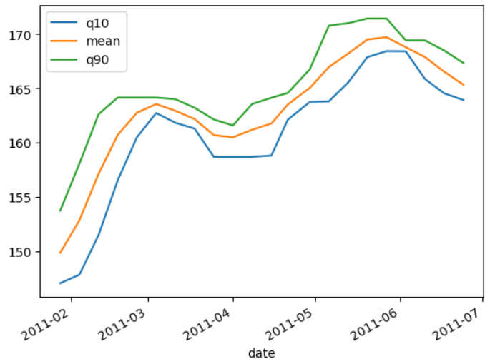
Moving Window Functions
Moving windows of fixed size 4
moving_average = data_ibm['open'].rolling(window=4)
q10 = moving_average.quantile(0.1).to_frame("q10")
mean = moving_average.mean().to_frame("mean")
q90 = moving_average.quantile(0.9).to_frame("q90")
pd.concat([q10, mean, q90], axis=1).plot()
Evaluation of different percentiles and conversion to data frame
Plot of all moving windows in the same graph

Slide 42
Moving Window Functions
Moving windows of fixed size 4
moving_average = data_ibm['open'].rolling(window=4)
q10 = moving_average.quantile(0.1).to_frame("q10")
mean = moving_average.mean().to_frame("mean")
q90 = moving_average.quantile(0.9).to_frame("q90")
pd.concat([q10, mean, q90], axis=1).plot()
Evaluation of different percentiles and conversion to data frame
Plot of all moving windows in the same graph
What can we observe in the graph?

Slide 43
Moving Window Functions
Moving windows of fixed size 4
moving_average = data_ibm['open'].rolling(window=4)
q10 = moving_average.quantile(0.1).to_frame("q10")
mean = moving_average.mean().to_frame("mean")
q90 = moving_average.quantile(0.9).to_frame("q90")
pd.concat([q10, mean, q90], axis=1).plot()
Evaluation of different percentiles and conversion to data frame
Plot of all moving windows in the same graph
What can we observe in the graph?
Different gaps indicate more/less variation over time

Slide 44
Task 5
Get the stock prices for GE, IBM, and MSFT.
Calculate the 4-week rolling mean of their open stock prices.
Plot all three rolling mean in a single graph.
Hint: Try to create a loop that will iterate over the different companies
Answer in the next slide...

Slide 45
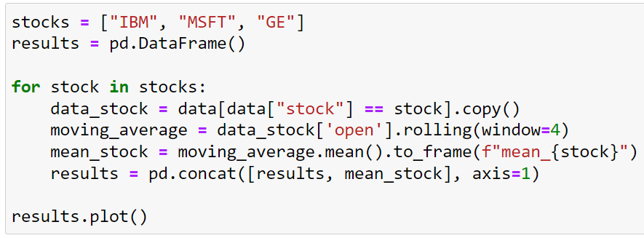
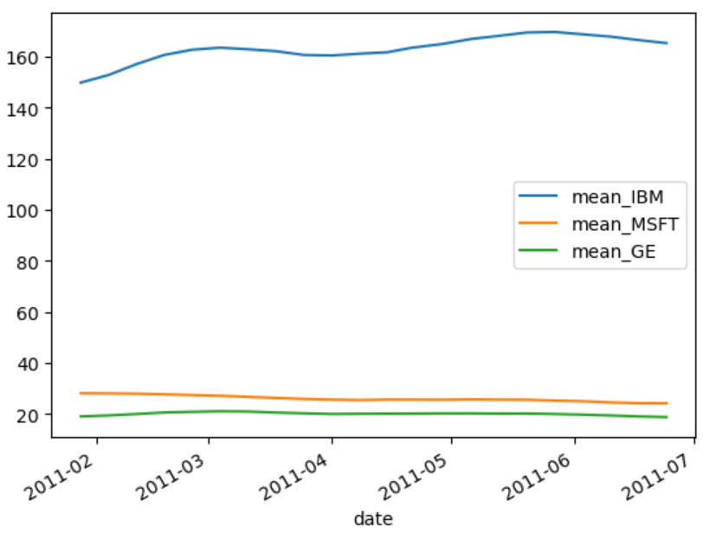
Task 5

Slide 46
Handling missing values
Some of the previous operators can be used as a simple way to handle missing data. For example:
Imputation with mean
Forward Fill: data['value'].fillna(method='ffill', inplace=True)
Backward Fill: data['value'].fillna(method='bfill', inplace=True)
Moving averages

Slide 47
Handling missing values
Some of the previous operators can be used as a simple way to handle missing data. For example:
Imputation with mean
Forward Fill: data['value'].fillna(method='ffill', inplace=True)
Backward Fill: data['value'].fillna(method='bfill', inplace=True)
Moving averages
Ignoring or removing missing values might also be a valid alternative if the amount is not too high.
More elaborated methods can also be used:
K-Nearest Neighbors: weighted average of the K-nearest time points
ML models: regression, neural networks
Domain specific approaches. For example, using external/domain knowledge to estimate values.

Slide 48
Task 6
Let’s fill missing values with a moving average window.
Use the data below as a simple example:
Create a rolling window of size 3 and calculate the moving average
Using the fillna method, pass the previous result to replace NAs
Hint: You will need to use the min_periods parameter of the rolling method.
data = {
'Date': pd.date_range(start='2023-11-02', periods=10, freq='D'),
'Value': [1.1, 2.2, np.nan, 4.4, 5.5, np.nan, np.nan, 8.8, 9.9, 10.0]
}
data = pd.DataFrame(data)
Answer in the next slide...

Slide 49
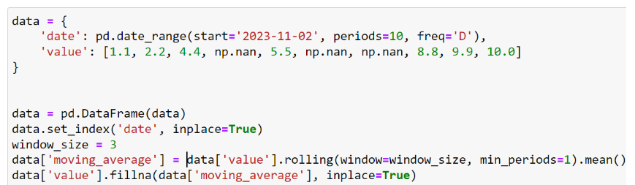
Task 6

Slide 50
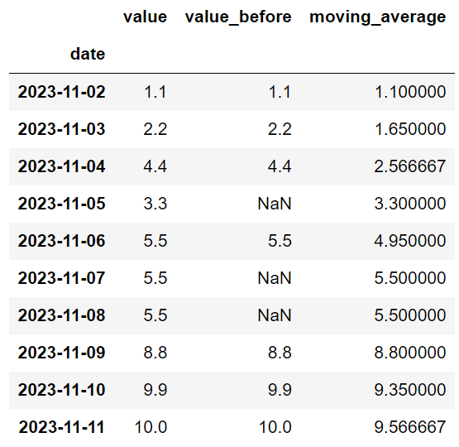
Task 6

Slide 51
Data Visualisation
Visualisations are important to help you gain insights with time series data.
Line Plots: fundamental visualization for time series data.
Can be enhanced to illustrate events or anomalies in the data. For example, highlighting points above/below a certain threshold.
Bar plots: good for comparison of aggregated data, such as monthly or yearly summaries
Histograms and boxplots: can still be used to describe frequency and data distribution on specific periods of time.
Heatmaps: these can divide date ranges into “bins”. The total number of points that fall within a bin determine its value and color.

Slide 52
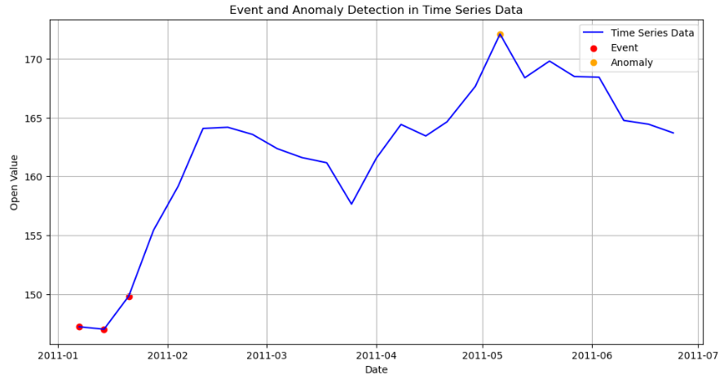
Line Plot

Slide 53
Line Plot
Points above the line are considered anomalies
Points below the line are considered events

Slide 54
Line Plot
import pandas as pd
import numpy as np
import matplotlib.pyplot as plt
plt.figure(figsize=(12, 6))
plt.plot(data_ibm.index, data_ibm['open'], label='Time Series Data', color='blue')
# Detect events and anomalies
anomaly_indices = data_ibm[data_ibm['open'] > 170].index
event_indices = data_ibm[data_ibm['open'] < 150].index
plt.scatter(event_indices, data_ibm['open'][event_indices], color='red', label='Event')
plt.scatter(anomaly_indices, data_ibm['open'][anomaly_indices], color='orange', label='Anomaly')
# Add labels and legend
plt.xlabel('Date')
plt.ylabel('Open Value')
plt.title('Event and Anomaly Detection in Time Series Data')
plt.legend()
# Show the plot
plt.grid(True)
plt.show()

Slide 55
Line Plot
import pandas as pd
import numpy as np
import matplotlib.pyplot as plt
plt.figure(figsize=(12, 6))
plt.plot(data_ibm.index, data_ibm['open'], label='Time Series Data', color='blue')
# Detect events and anomalies
anomaly_indices = data_ibm[data_ibm['open'] > 170].index
event_indices = data_ibm[data_ibm['open'] < 150].index
plt.scatter(event_indices, data_ibm['open'][event_indices], color='red', label='Event')
plt.scatter(anomaly_indices, data_ibm['open'][anomaly_indices], color='orange', label='Anomaly')
# Add labels and legend
plt.xlabel('Date')
plt.ylabel('Open Value')
plt.title('Event and Anomaly Detection in Time Series Data')
plt.legend()
# Show the plot
plt.grid(True)
plt.show()
Threshold values used

Slide 56
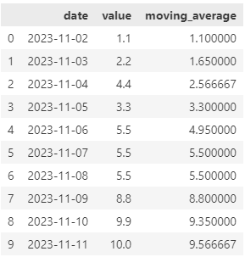
Task 7
Using the values and moving averages calculated on Task 6 plot a line graph showing both columns over time.
Highlight the value points in which value - moving_average > 1.
Hint: You will need to specify the dates and values using .loc after detecting the points of interest and plotting the scatter plot.
Solutions in the next slide...

Slide 57
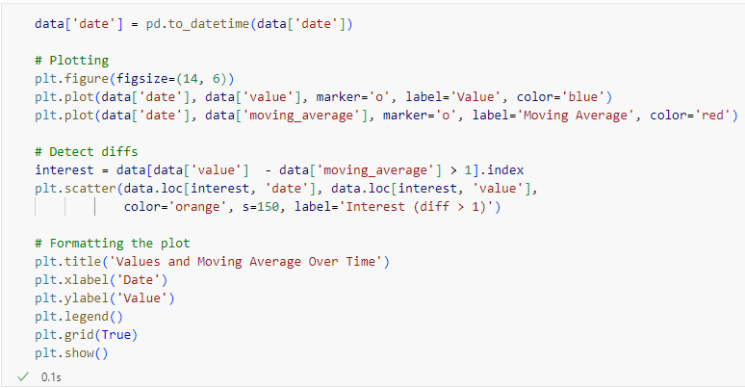
Task 7

Slide 58
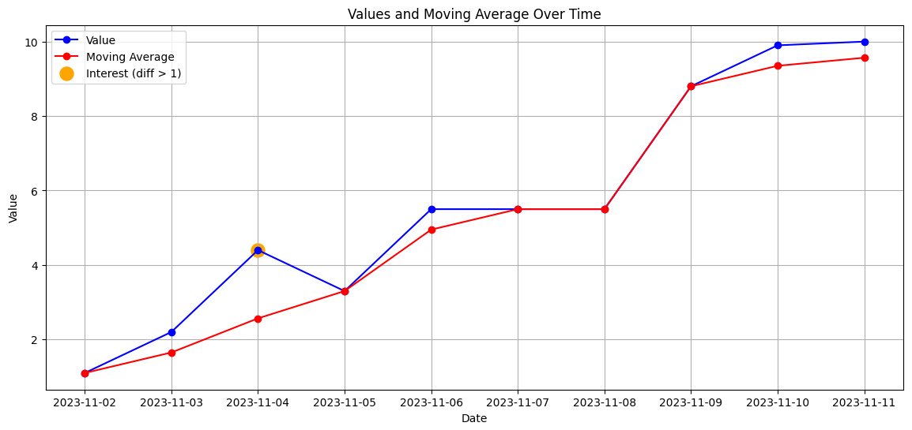
Task 7

Slide 59
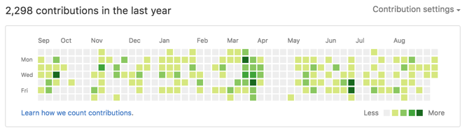
Heatmap

Slide 60
Heatmap
import pandas as pd
import numpy as np
import matplotlib.pyplot as plt
# Reshape the data to create a pivot table
pivot_table = data_ibm.pivot_table(index='date', columns='open', aggfunc='size', fill_value=0)
plt.figure(figsize=(10, 10))
plt.imshow(pivot_table)
# Customize the heatmap
plt.xlabel('Date')
plt.ylabel('Open')
plt.colorbar(label='Frequency')
plt.title('Event Frequency Heatmap')
plt.xticks(range(len(pivot_table.index)), pivot_table.index.strftime('%Y-%m-%d'), rotation=90)
plt.yticks(range(len(pivot_table.columns)), pivot_table.columns)
plt.show()

Slide 61
Heatmap
import pandas as pd
import numpy as np
import matplotlib.pyplot as plt
# Reshape the data to create a pivot table
pivot_table = data_ibm.pivot_table(index='date', columns='open', aggfunc='size', fill_value=0)
plt.figure(figsize=(10, 10))
plt.imshow(pivot_table)
# Customize the heatmap
plt.xlabel('Date')
plt.ylabel('Open')
plt.colorbar(label='Frequency')
plt.title('Event Frequency Heatmap')
plt.xticks(range(len(pivot_table.index)), pivot_table.index.strftime('%Y-%m-%d'), rotation=90)
plt.yticks(range(len(pivot_table.columns)), pivot_table.columns)
plt.show()
Reshape the dataframe

Slide 62
Heatmap
import pandas as pd
import numpy as np
import matplotlib.pyplot as plt
# Reshape the data to create a pivot table
pivot_table = data_ibm.pivot_table(index='date', columns='open', aggfunc='size', fill_value=0)
plt.figure(figsize=(10, 10))
plt.imshow(pivot_table)
# Customize the heatmap
plt.xlabel('Date')
plt.ylabel('Open')
plt.colorbar(label='Frequency')
plt.title('Event Frequency Heatmap')
plt.xticks(range(len(pivot_table.index)), pivot_table.index.strftime('%Y-%m-%d'), rotation=90)
plt.yticks(range(len(pivot_table.columns)), pivot_table.columns)
plt.show()
Index and columns used

Slide 63
Heatmap
import pandas as pd
import numpy as np
import matplotlib.pyplot as plt
# Reshape the data to create a pivot table
pivot_table = data_ibm.pivot_table(index='date', columns='open', aggfunc='size', fill_value=0)
plt.figure(figsize=(10, 10))
plt.imshow(pivot_table)
# Customize the heatmap
plt.xlabel('Date')
plt.ylabel('Open')
plt.colorbar(label='Frequency')
plt.title('Event Frequency Heatmap')
plt.xticks(range(len(pivot_table.index)), pivot_table.index.strftime('%Y-%m-%d'), rotation=90)
plt.yticks(range(len(pivot_table.columns)), pivot_table.columns)
plt.show()
Size counts the number of occurrences for each combination of 'date' and 'open'

Slide 64
Heatmap
import pandas as pd
import numpy as np
import matplotlib.pyplot as plt
# Reshape the data to create a pivot table
pivot_table = data_ibm.pivot_table(index='date', columns='open', aggfunc='size', fill_value=0)
plt.figure(figsize=(10, 10))
plt.imshow(pivot_table)
# Customize the heatmap
plt.xlabel('Date')
plt.ylabel('Open')
plt.colorbar(label='Frequency')
plt.title('Event Frequency Heatmap')
plt.xticks(range(len(pivot_table.index)), pivot_table.index.strftime('%Y-%m-%d'), rotation=90)
plt.yticks(range(len(pivot_table.columns)), pivot_table.columns)
plt.show()
In case of no occurrences of open in a date, cell will be filled with 0

Slide 65
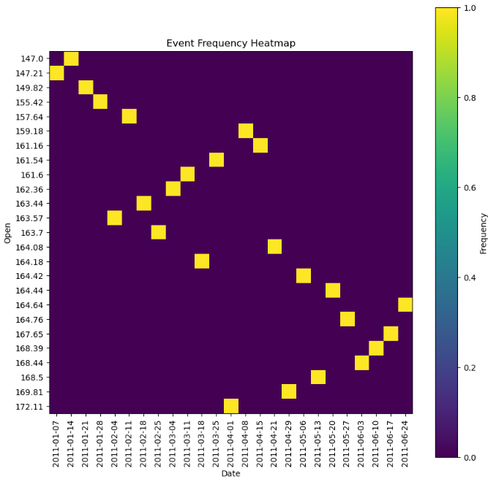
Heatmap
Is this visualization good?

Slide 66
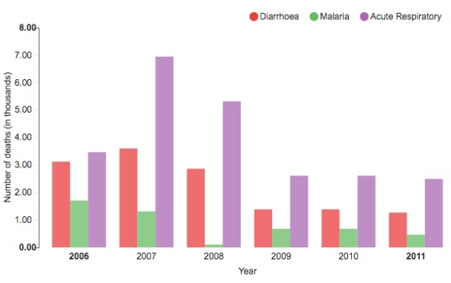
Bar plot

Slide 67
Bar plot
import pandas as pd
import matplotlib.pyplot as plt
import numpy as np
pivot_table = data_ibm.pivot(columns='stock', values='open')
dates = pivot_table.index.strftime('%B %d, %Y')
groups = pivot_table.columns
bar_width = 0.40
# Create an array of x-axis positions for each group
x = np.arange(len(dates))
fig, ax = plt.subplots(figsize=(10, 6))
for i, group in enumerate(groups):
ax.bar(x + i * (bar_width), pivot_table[group], width=bar_width, label=group)
ax.set_xlabel('Date')
ax.set_ylabel('Value')
ax.set_title('Daily comparison')
ax.set_xticks(x + (bar_width * (len(groups) - 1) / 2))
ax.set_xticklabels(months)
ax.legend(title='Stocks')
ax.set_ylim(15, 30)
plt.xticks(rotation=90)
plt.show()

Slide 68
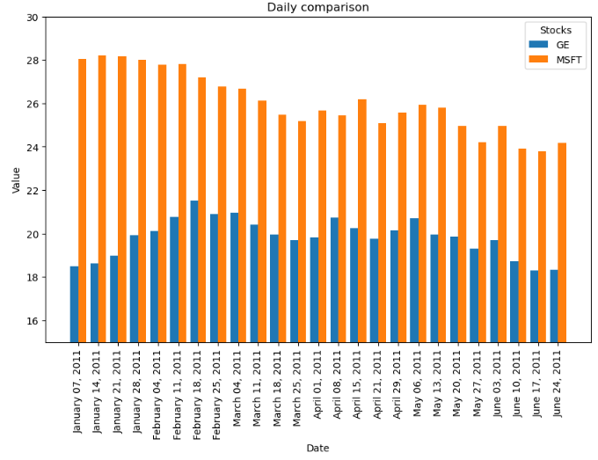
Bar plot

Slide 69
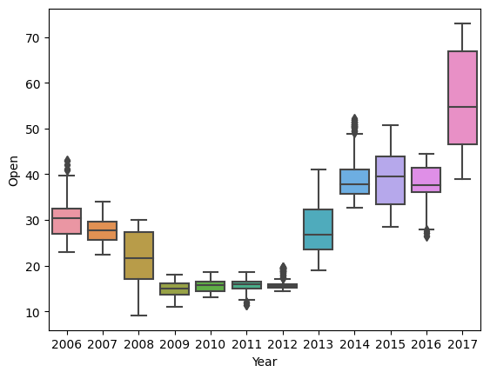
Box plots

Slide 70
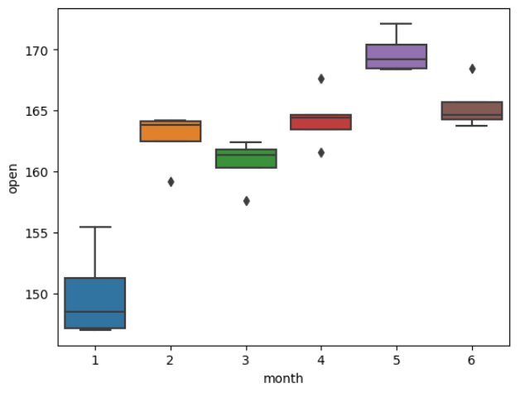
Box plots
import seaborn as sns
data_ibm["month"] = data_ibm.index.month
sns.boxplot(data=data_ibm, x="month", y="open")

Slide 71
Summary
Time series data definition
Loading and converting time series data
Resampling and frequency conversion
Handling missing values
Data visualisations

Slide 72
References
Python for Data Analysis 3E
Pandas documentation
UCI repository for stock data used
Geeks for Geeks tutorial
Data camp courses:
Time series in Python
Time series in R

Slide 73
Lab
Please complete the lab on Week 12 folder.

Slide 74
Questions?

